Slide 1
Lecture 1. Computer Architecture & Design Overview
CMPE 200 Computer Architecture & Design
Haonan Wang

Slide 2
Abstraction of Computers
CS/SE
CMPE
Software/Applications
Operating System
Compiler
Firmware
CMPE140
ISA
Processor
Registers
Cache
Memory
HDD/SSD
Datapath & Control
Digital Design
Circuit Design
EE/Phys
Semiconductor physics

Slide 3
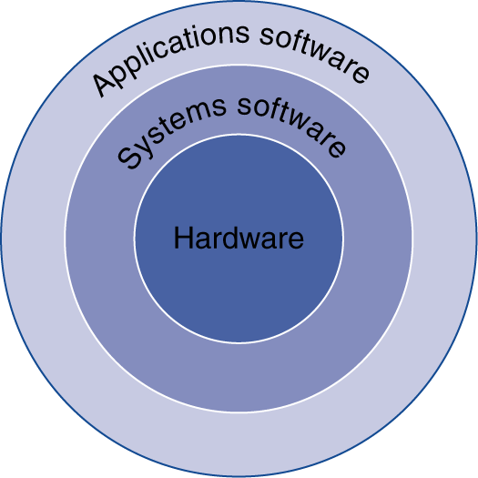
The Software’s Point of View
Application software
Written in high-level language
System software
Compiler: translates HLL code to machine code
Operating System: service code
Handling input/output
Managing memory and storage
Scheduling tasks & sharing resources
Hardware
Processor, memory, I/O controllers, …

Slide 4
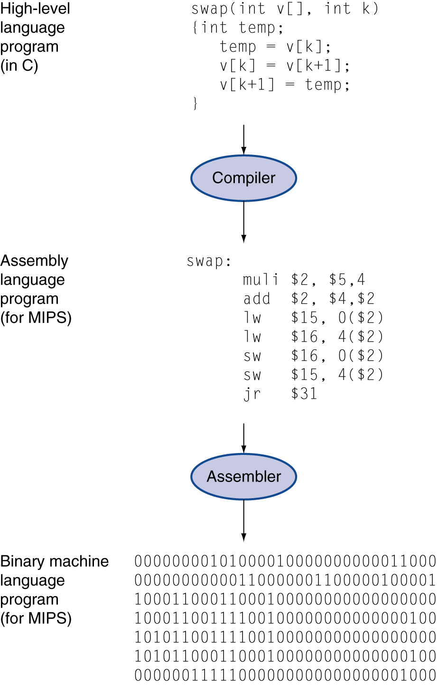
The Codes’ Point of View
High-level language
Abstraction Level closer to problem domain
Provides for productivity and portability
Assembly language
Textual representation of instructions
Hardware representation
Binary digits (bits)
Encoded instructions and data

Slide 5
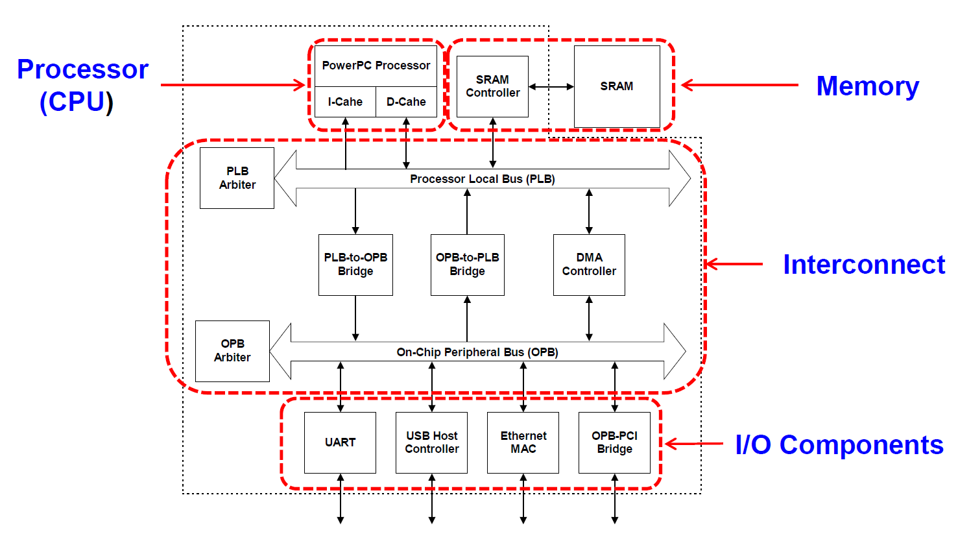
Hardware’s Point of View
Computer Organization:
Nowadays DRAM

Slide 6
Your Thoughts
Try to conclude with as few words as possible:
Computer Organization vs. Computer Architecture
– What is the key difference?

Slide 7

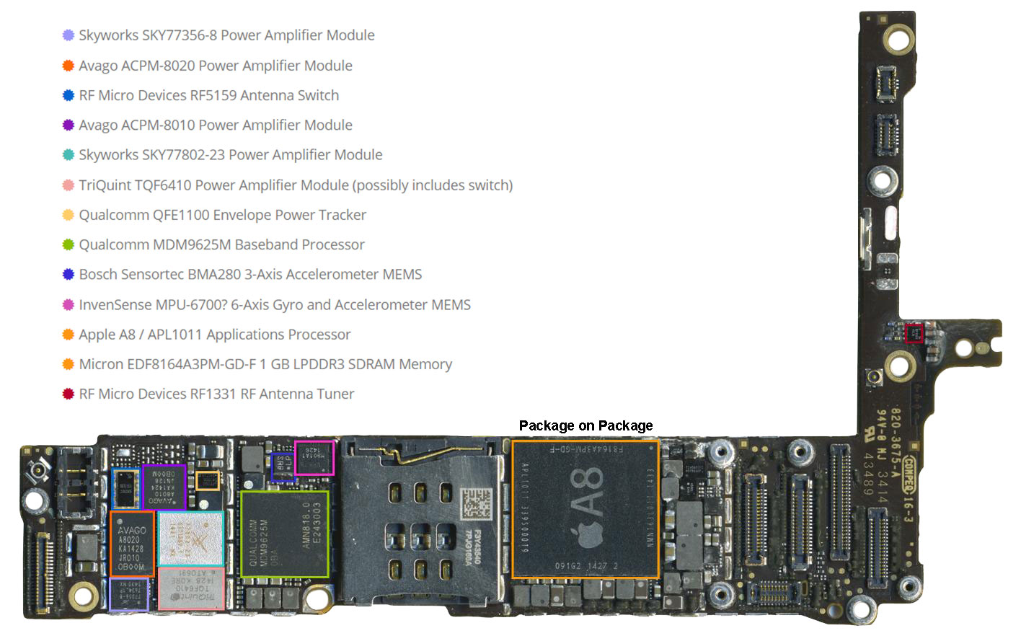
Hardware Examples
Processor
Main memory
(SDRAM)
Figures from http://www.techinsights.com/teardown.com/apple-iphone-6/

Slide 8
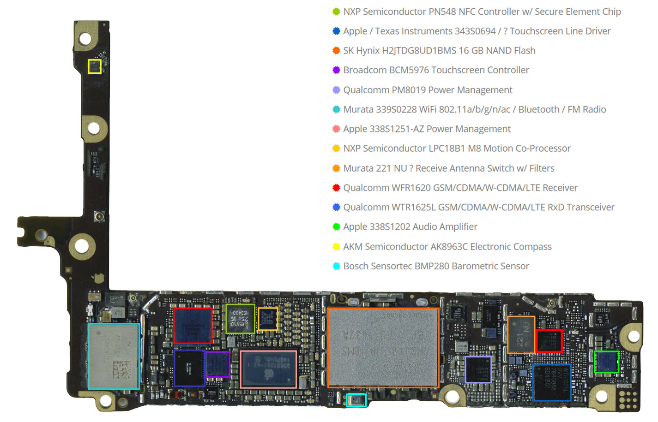
Hardware Examples
Storage
(NAND Flash)
Input/output device
(touch screen)
Figures from http://www.techinsights.com/teardown.com/apple-iphone-6/

Slide 9
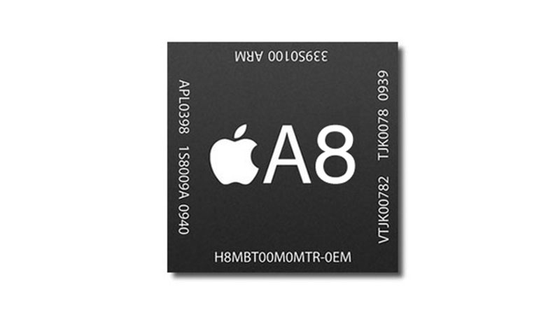
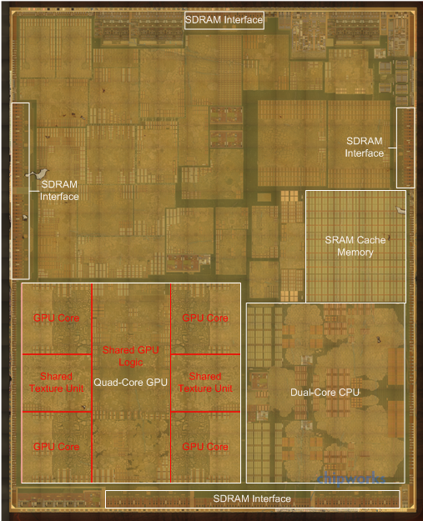
Hardware Examples
What is the advantage of having them in the same package?
Figures from http://www.anandtech.com/show/8562/chipworks-a8

Slide 10


Electronic Components’ Point of view
Transistors
3-terminal device
Gate input: the control input; its voltage determines whether current can flow
Source & Drain: terminals that current flows from/to
Many transistors can be fabricated on one piece of silicon (i.e. an integrated chip, IC)
Gate +5V
Transistor is ‘on’
Source
Drain
-
-
High voltage at gate allows current to flow between source and drain
-
-
-
-
Silicon
Gate 0V
Transistor is ‘off’
Source
Drain
-
-
Low voltage at gate prevents current from flowing between drain and source
Silicon
Integrated Circuit
Actual silicon wafer is quite small but can contain several billion transistors
Silicon wafer is then packaged to form the chips we are familiar with

Slide 11
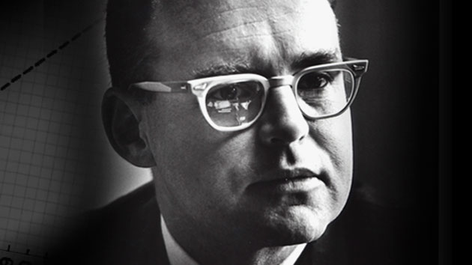
Moore’s Law (1965)
In 1975, he recalibrated it to every two years.
Later, it is recalibrated again to 18 months, as is widely known as Moore’s Law.
“The number of transistors per square inch on integrated circuits had doubled every year since the integrated circuit was invented and this trend would continue for the foreseeable future.”
-- Gordon E. Moore, “Cramming More Components onto Integrated Circuits,” Electronics, pp. 114–117, April 19, 1965.

Slide 12
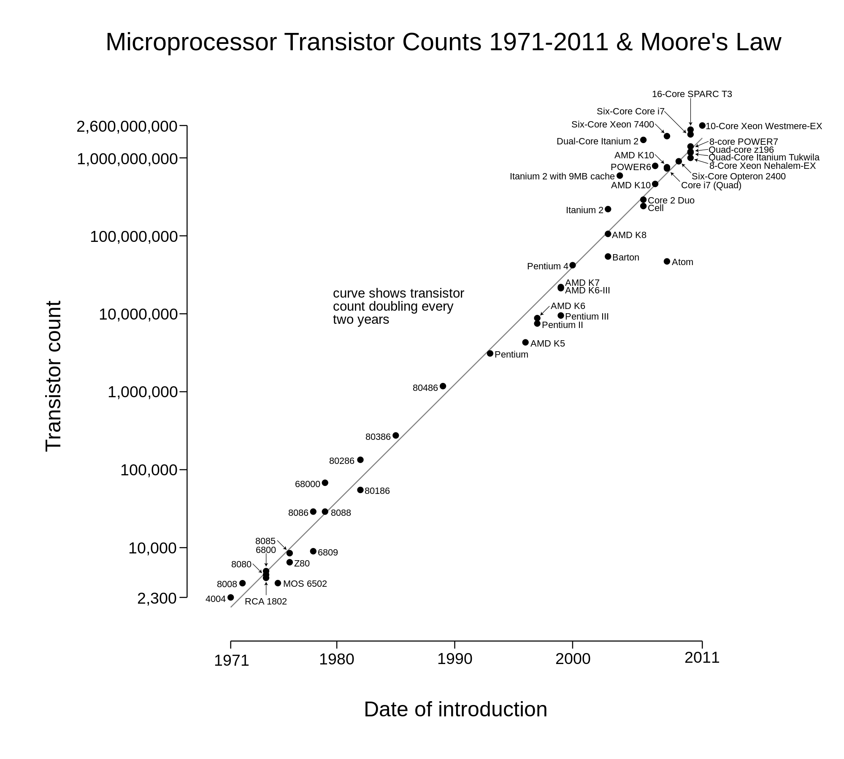
Moore’s Law (1965)
The law has been preserved over four decades..

Slide 13
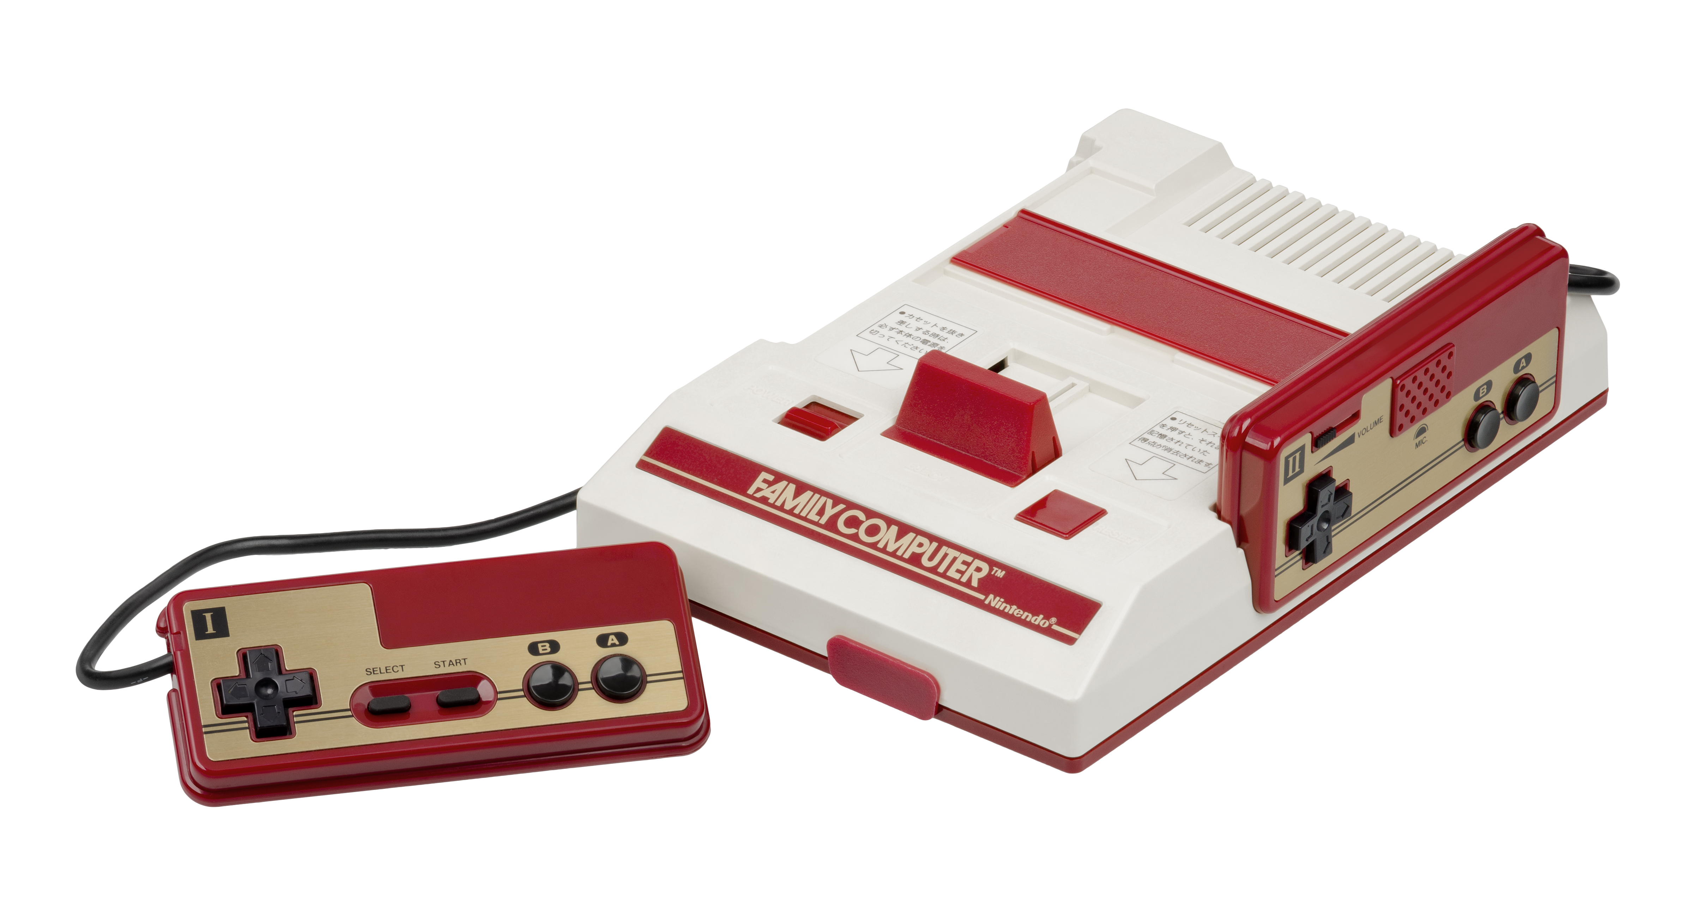

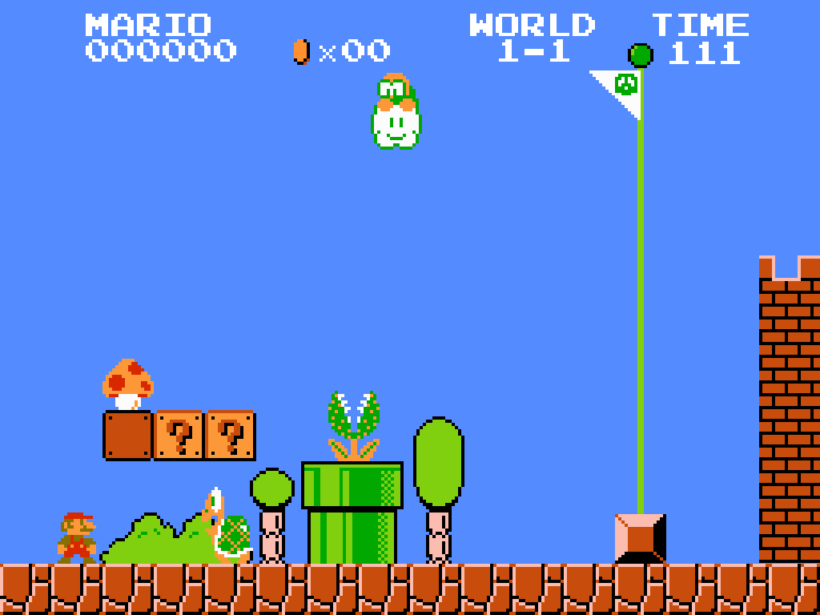



What Does It Enable?
Applications that were impossible to run on the computers before
3D games, Augmented reality, Virtual reality, Deep learning…

Slide 14
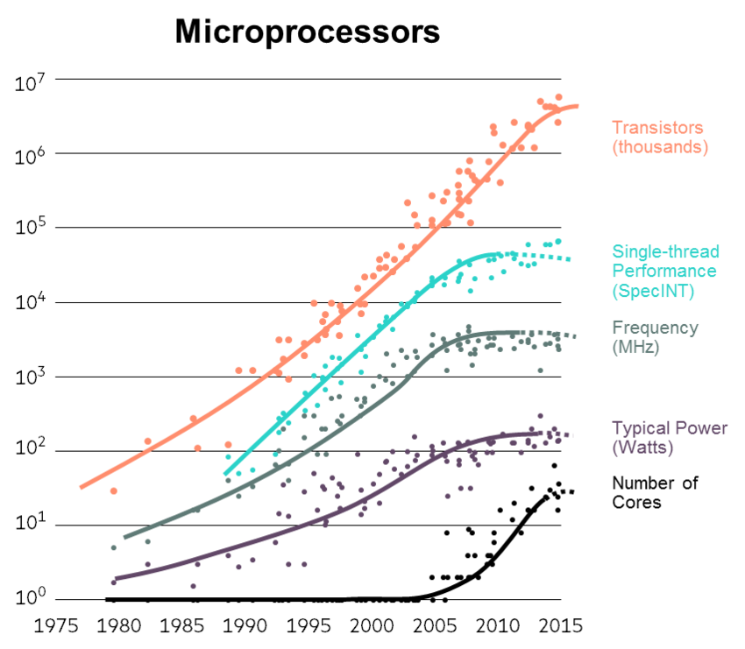
Moore’s Law (1965)
Will it last forever?
Dead?

Slide 15
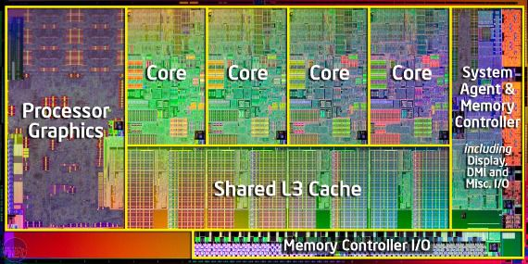
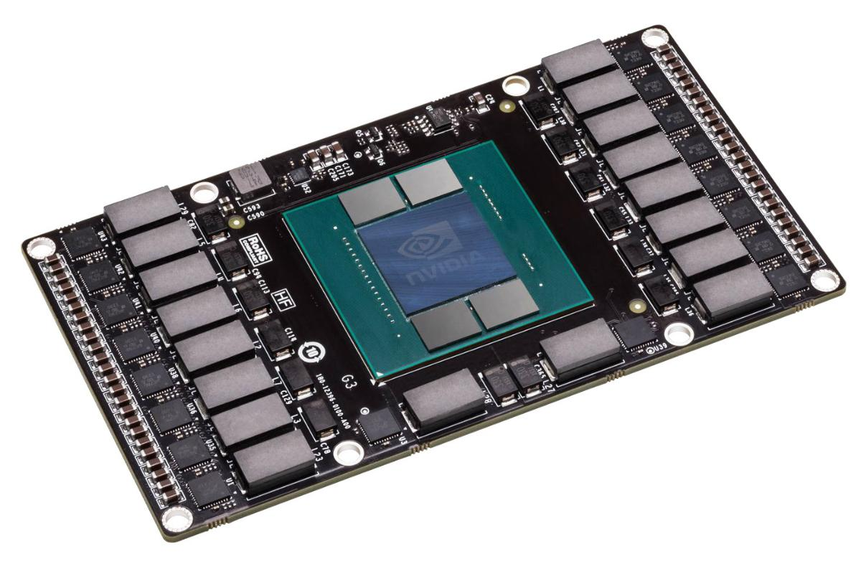
Current Trend of Computer Systems
Multi- or Many-core Processors
- Embedding multiple cores in one CPU
Complex microarchitecture
- Out-of-order execution, branch predictor, memory prefetcher, etc..
Accelerators
- GPUs, FPGAs, etc..
- Application specific designs
Novel architectures
- Dark silicon, 3D-stacking, neuromorphic computing, quantum, etc..

Slide 16
Metrics: How Do We Evaluate a System?
Performance (speed)
Response time (Latency):
How long it takes to do a task
Throughput :
Total work done per unit time
Power efficiency
How much power it consumes to do a task
Cost

Slide 17
What Determines Performance?
Algorithm
Determines number of operations executed
Programming language, compiler, architecture
Determine number of machine instructions executed per operation
Processor and memory system
Determine how fast instructions are executed
I/O system (including OS)
Determines how fast I/O operations are executed

Slide 18
Relative Performance
Define Performance = 1/Execution Time
“X is n times faster than Y”

Slide 19
Measuring Execution Time
Elapsed time
Total response time, including all aspects
Processing, I/O, OS overhead, idle time
Determines system performance
CPU time
Time spent processing a given job on CPU
Discounts I/O time, other jobs’ shares
Estimating CPU time is relatively easy based on the number of lines of code and processing speed of the CPU

Slide 20
CPU Clocking
Operation of digital hardware governed by a constant-rate clock
Different system components may have different clock rates
A clock cycle
Clock period
Clock (cycles)
Data transfer and computation
Update state
Clock period: duration of a clock cycle
e.g., 250ps = 0.25ns = 250×10^{–12}s
Clock frequency (rate): cycles per second
e.g., 4.0GHz = 4000MHz = 4.0×10⁹Hz

Slide 21
CPU Time Estimation
A code line of high-level language program can be translated to one or multiple assembly code lines
CPU processes a piece of machine code for each assembly code line, one by one
Example: Application A has 1000 assembly lines. CPU has 250 ps clock period.
Clock cycles for Application A
= 1000 cycles
CPU time for Application A
= 1000 cycles x 250 ps = 250×10^{–9}s

Slide 22
CPU Time
CPU Time = Clock Cycles x Clock Period
= Clock Cycles / Clock Frequency

Slide 23
Instruction Count and CPI
An assembly line is also called one Instruction
In some CPUs, an instruction may take multiple clock cycles
CPU Time equation can be rewritten
Cycles Per Instruction is also called CPI
CPU Time
= Clock Cycles x Clock Period
= Instruction Count x Cycles Per Instruction x Clock Period

Slide 24
CPI Example
A program takes 33 billion instructions to run
CPU processes instructions at 2 cycles per instruction
Clock speed is 3GHz
What is estimated CPU Time for this program?
CPU Time = Instruction Count x CPI x Clock Period
= 33 x 10⁹ x 2 x 1/(3 x 10⁹)
= 22 seconds

Slide 25
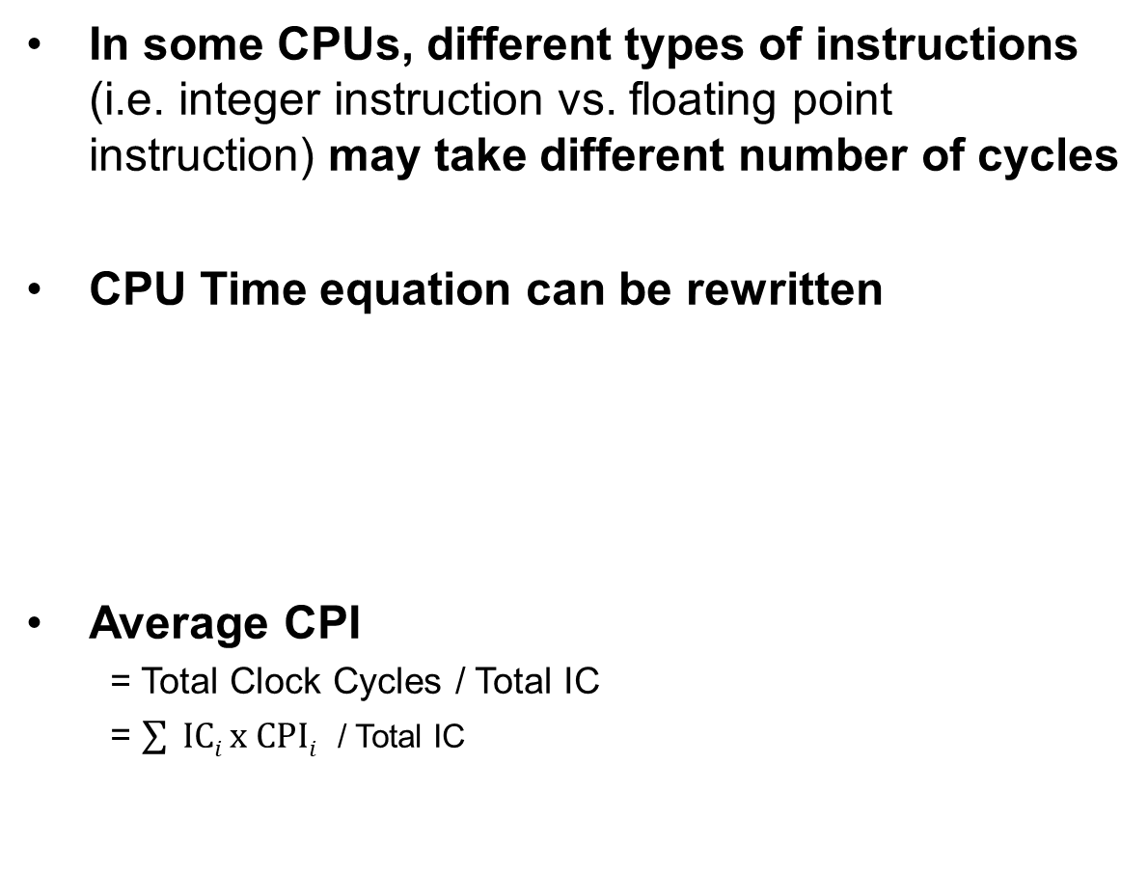
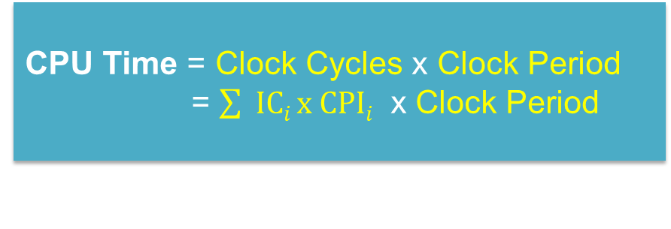
CPI and Average CPI
In some CPUs, different types of instructions (i.e. integer instruction vs. floating point instruction) may take different number of cycles
CPU Time equation can be rewritten
Average CPI
= Total Clock Cycles / Total IC
= $\sum{ ICi x CPIi}$ / Total IC
CPU Time = Clock Cycles x Clock Period
= $\sum{ ICi x CPIi}$ x Clock Period
Sum of (IC of each type instruction x CPI of the type)
(IC = instruction count)

Slide 26
Example: Average CPI
Instruction Type | Integer | Floating point | Branch | Load/ Store
CPI for type | 1 | 2 | 4 | 3
Instruction Count in program A | 50 | 10 | 10 | 10
Instruction Count in program B | 20 | 0 | 10 | 10
Program A: Total Instructions = 80
Clock Cycles = 50×1 + 10×2 + 10×4 + 10x3 = 140
Avg. CPI = 140/80 = 1.75
CPU time (if Clock period = 100 ps)
= 1.75 x 80 x 100ps = 14000 ps = 14ns

Slide 27
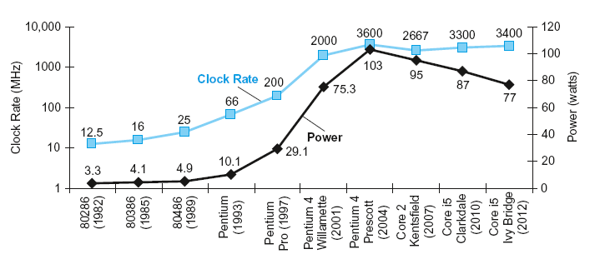
Power and Performance
In CMOS IC technology
Power = Capacitive load x Voltage² x Frequency

Slide 28
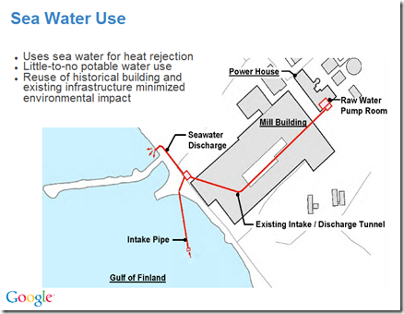

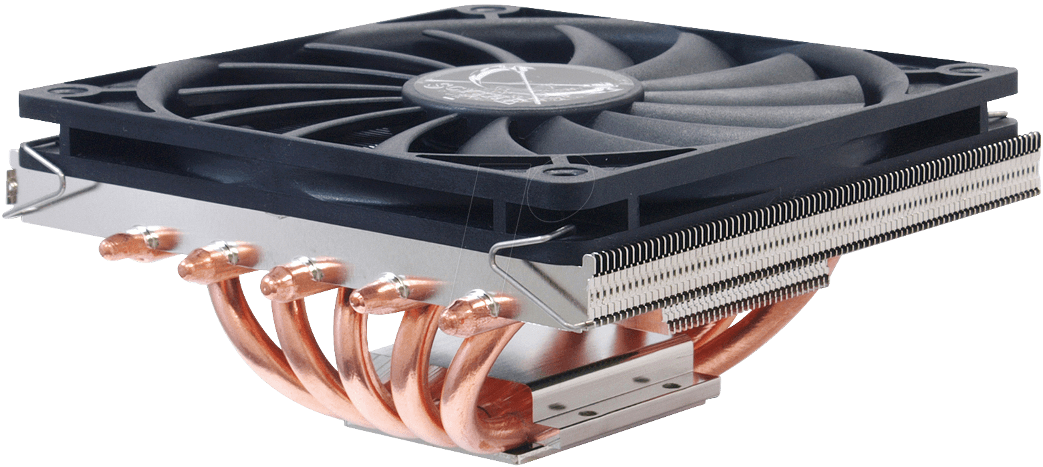
Issue with Power Scaling
Increasing core frequency may burn your processor!
- Almost all energy consumption turns into heat
Cooling is costly
Design more efficient system instead
- Multicore, etc..

Slide 29


